Slide 1

ECE 220 Computer Systems & Programming
Lecture 13 – Problem Solving with Pointers and Arrays
October 9, 2019
Notes:
ECE Main Slide

Slide 2
Exercise: implement a function that interchanges two rows of a 5x5 matrix. The functions takes three arguments: pointer to the matrix, row number x and row number y.
#define SIZE 5
void row_interchange(int *matrix, int x, int y){
}
Note:
2D arrays
<type> <name> [<dim1>][<dim2>];
e.g., int matrix[5][5];
*multi-dimensional array is stored in row-major order
linear index = row x (width of row) + col
(i.e. matrix[3][2] = 3*5+2 = 17)
10

Slide 3
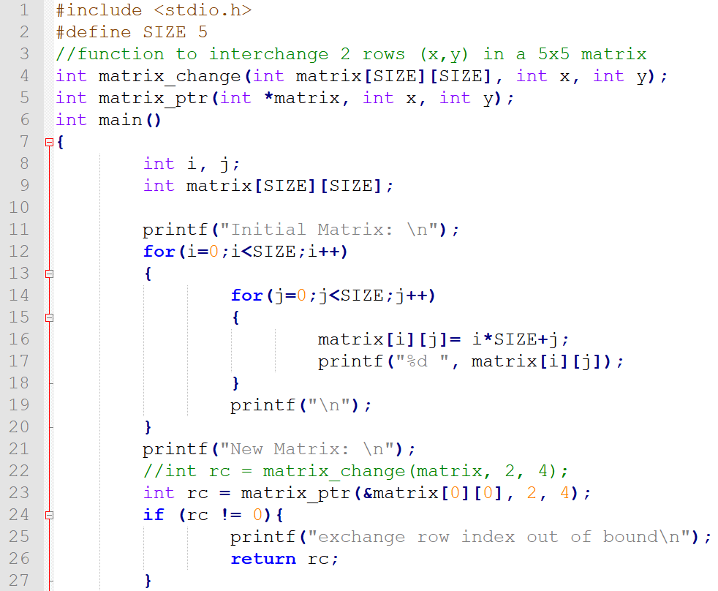

Slide 4
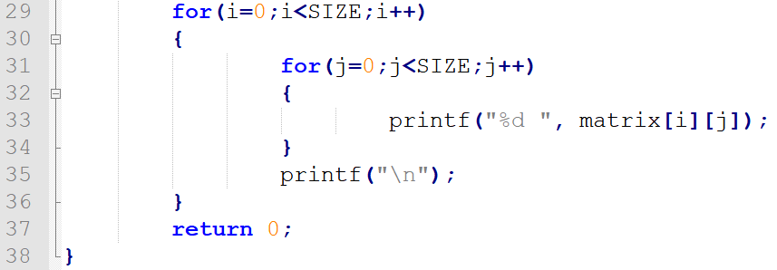
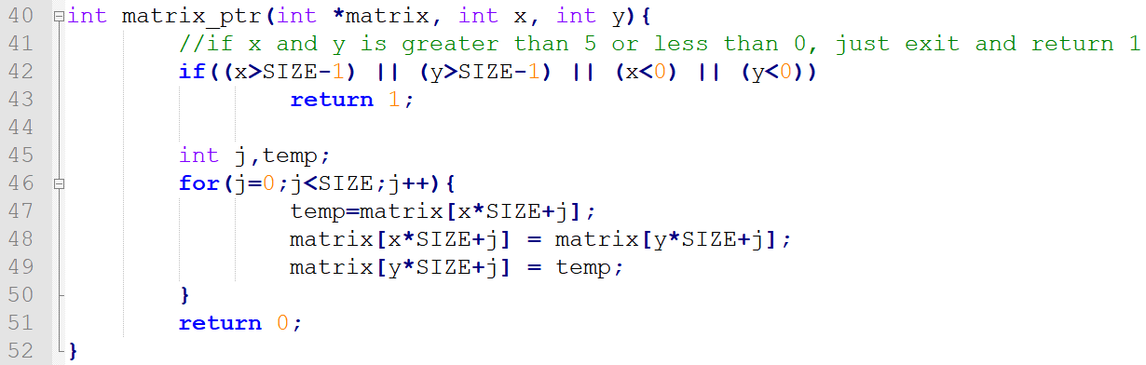
main Function (continue..)

Slide 5
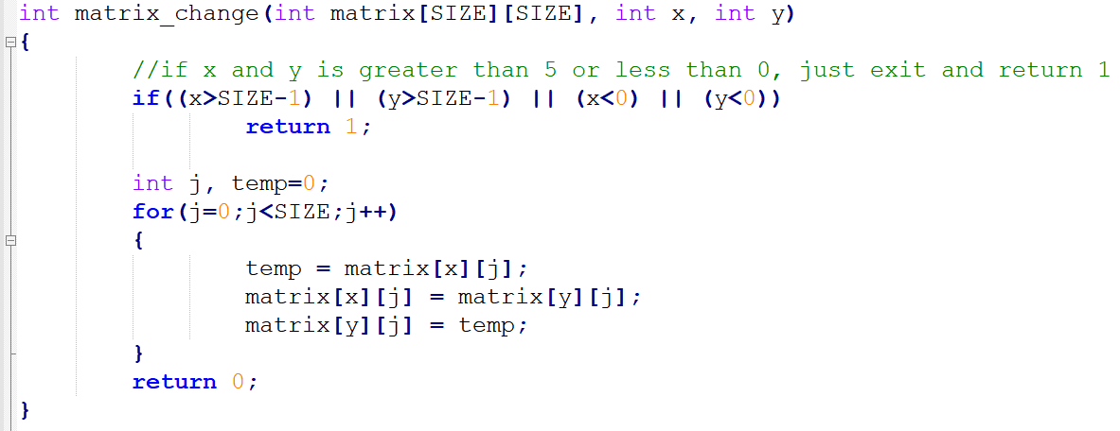
Function without pointer argument:

Slide 6
Pointers & Array Recap
Reverse an integer array: void array_reverse(int array[], int size);
Index: 0 1 2 3
Index: 0 1 2 3 4
10 | 30 | 50 | 70
10 | 30 | 50 | 70 | 90
2

Slide 7
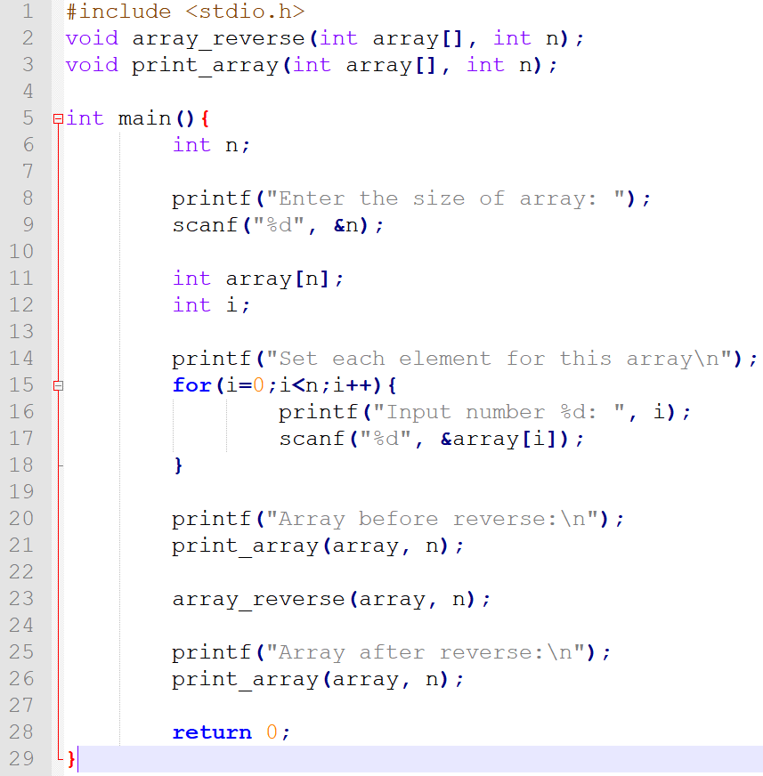

Slide 8
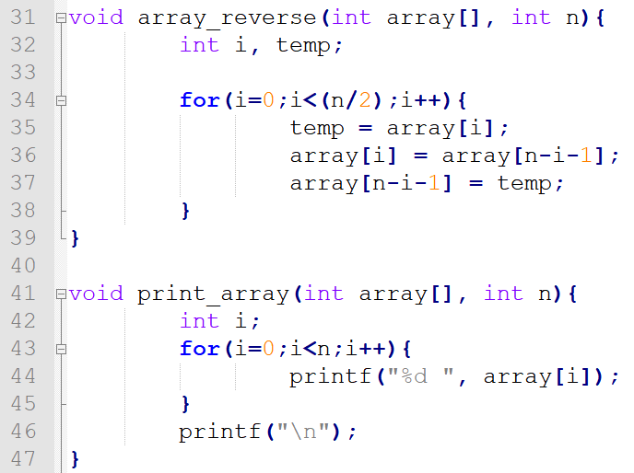
How about reversing a string of unknown size? See the Text, page 445 (code on github)

Slide 9
Multi-dimensional Arrays Recap
 | Column 1 | Column 2 | Column 3
Row 1 | a[0][0] | a[0][1] | a[0][2]
Row 2 | a[1][0] | a[1][1] | a[1][2]
int a [2][3];
In memory index
* multi-dimensional array is stored in row-major order
a[0][0]
a[0][1]
a[0][2]
a[1][0]
a[1][1]
a[1][2]
0
1
2
3
4
5
3

Slide 10
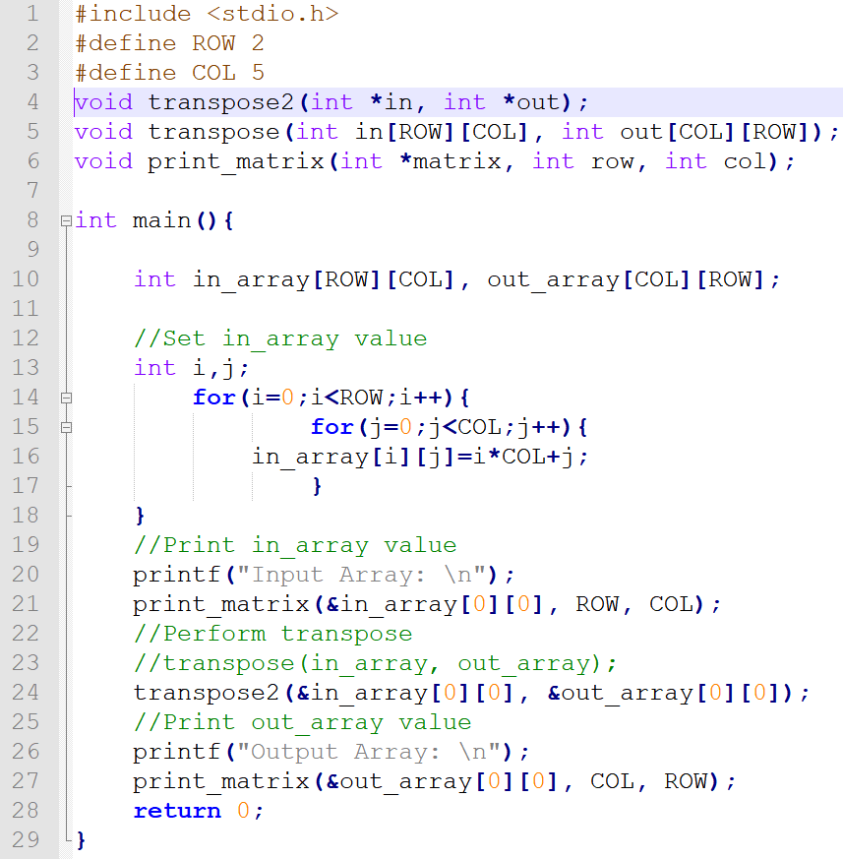
Exercise:
Implement a function that transpose an n x m matrix
4

Slide 11
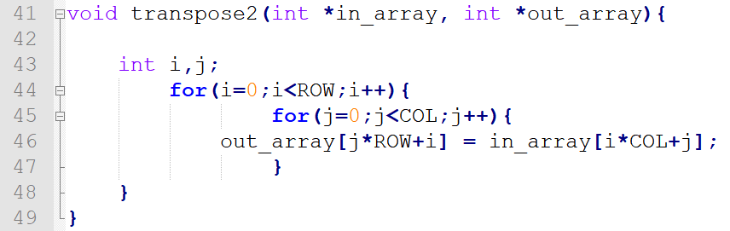
#define ROW 2
#define COL 5
void transpose2(int *in_matrix, int *out_matrix){
Solution:
}
5

Slide 12
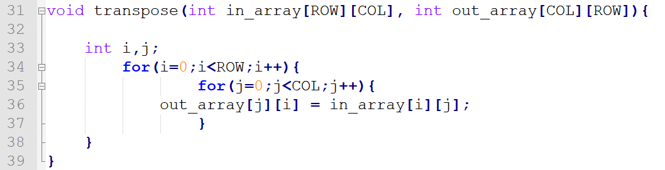
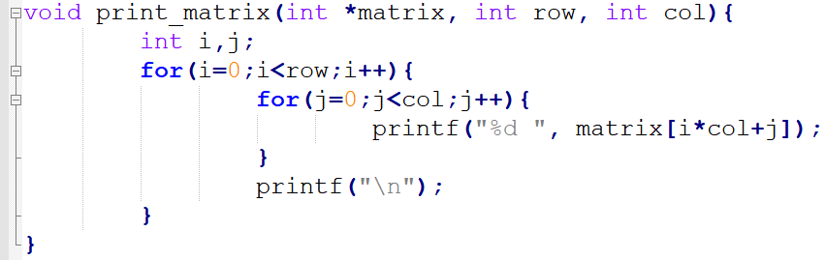
Exercise: implement a function that transpose an n x n matrix
#define ROW 2
#define COL 5
void transpose(int in_matrix[ROW][COL], int out_matrix[COL][ROW]){
Simpler Solution:
}
Print Function:
4

Slide 13
1. Pointer Array & Pointer to an Array
int a[4];
int b[5];
int *ptr_array[2];
ptr_array[0] = &a[0]; /* ptr_array[0] = a; */
ptr_array[1] = &b[0]; /* ptr_array[1] = b; */
or
int a[4];
int b[5];
int *ptr_array[2] = {a,b};
6

Slide 14
2. Search Algorithms
Linear Search: search from the beginning of the array until item is found
Binary Search: (for sorted array)
1) find the middle of the array and check if it’s the search item;
2) search the first half if the search item is smaller than the center item, else search the second half;
3) repeat step 1 & 2 until search item is found.
7

Slide 15
Exercise: implement a function that performs binary search
This function takes two arguments: a pointer to the sorted array and the search item. If the search item is found, the function returns its index in the array. Otherwise, it returns -1.
#define SIZE 8
int binary_search(int array[], int item)
{
}
8

Slide 16
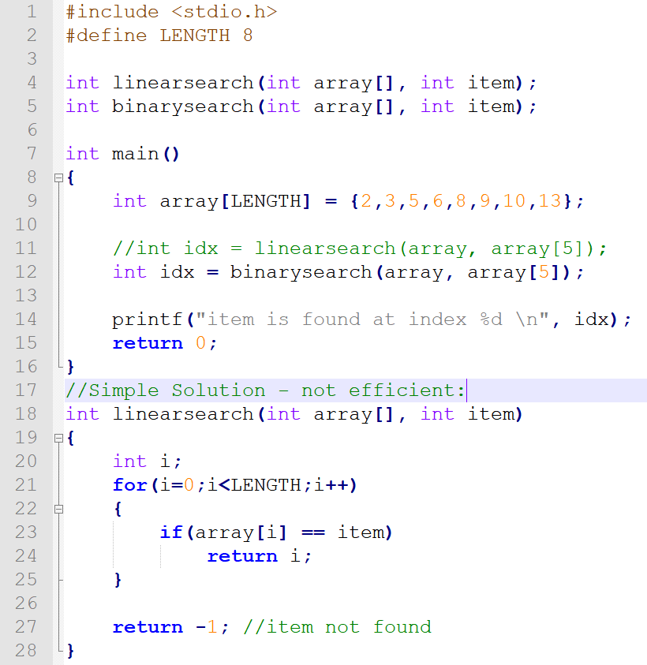

Slide 17
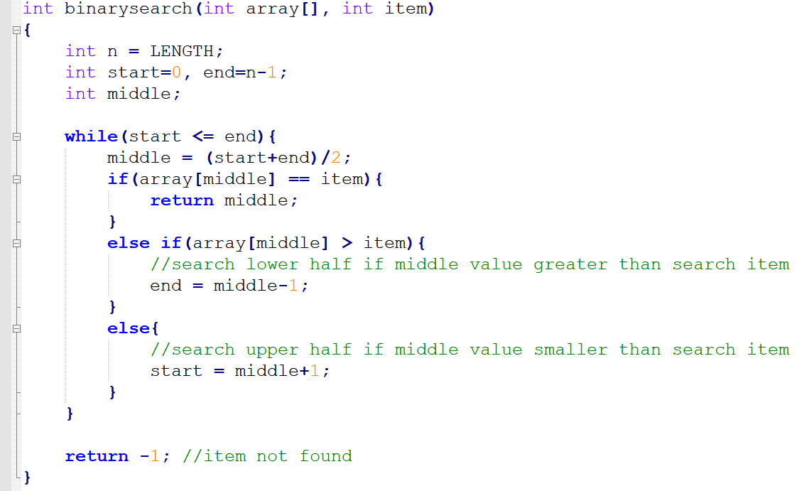
Exercise: implement a function that performs binary search
This function takes two arguments: a pointer to the sorted array and the search item. If the search item is found, the function returns its index in the array. Otherwise, it returns -1.
8

Slide 18
3. Sorting Algorithms (bubble_sort)
Bubble Sort: 1) compare items next to each other and swap them if needed;
2) repeat this process until the entire array is sorted.
9

Slide 19

3. Sorting Algorithms (bubble_sort animation)
Bubble Sort: 1) compare items next to each other and swap them if needed;
2) repeat this process until the entire array is sorted.
9

Slide 20
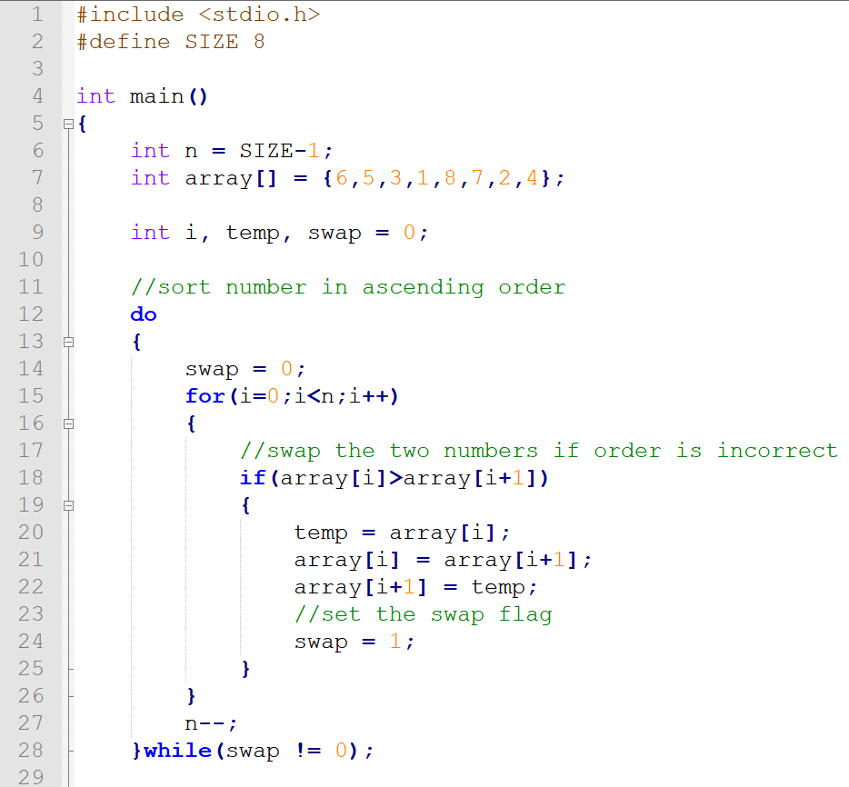
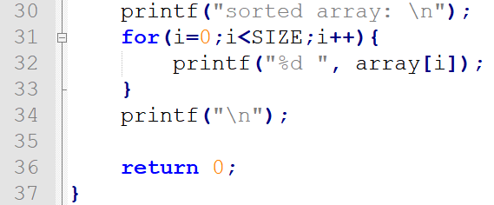
Exercise: implement a function that performs bubble sort

Slide 21
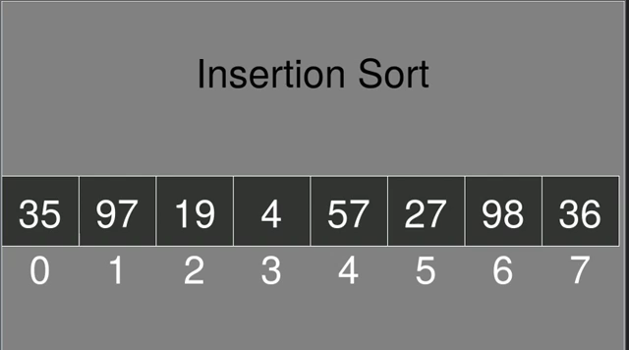
4. Sorting Algorithms (Insertion Sort animation)
Bubble Sort: 1) compare pairs to the left and swap them if needed;
2) repeat this process until the entire array is sorted.
9

Slide 22
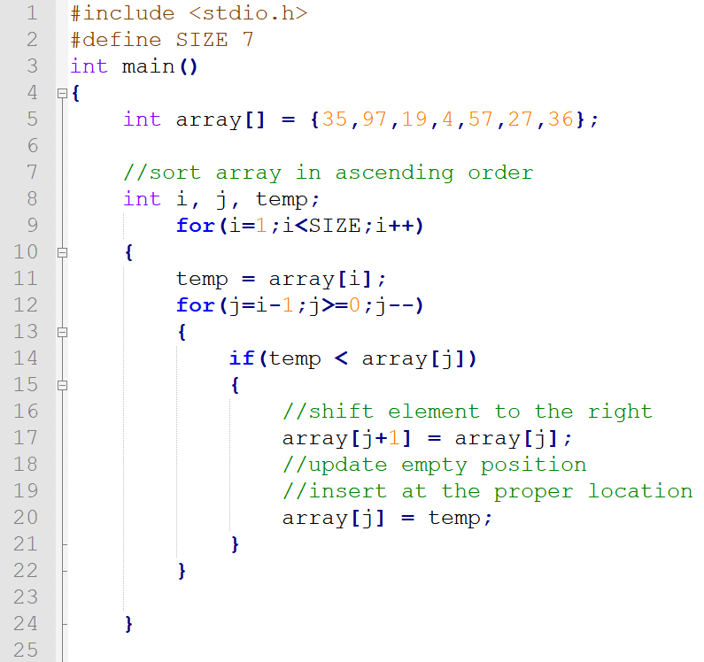
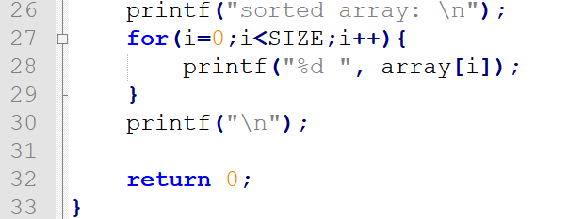
Exercise: implement a function that performs insertion sort
12

Slide 23

Merge_Insertion Sort:
1) remove item from array, insert it at the proper location in the sorted part by shifting other items;
2) repeat this process until the end of array is reach.
11

Slide 24
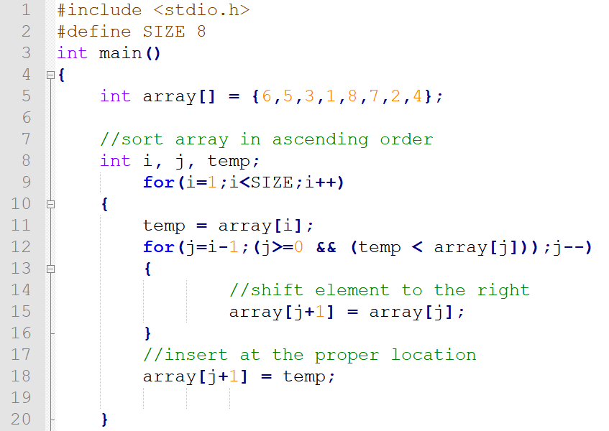
Exercise: implement a function that performs insertion sort
12

Slide 25
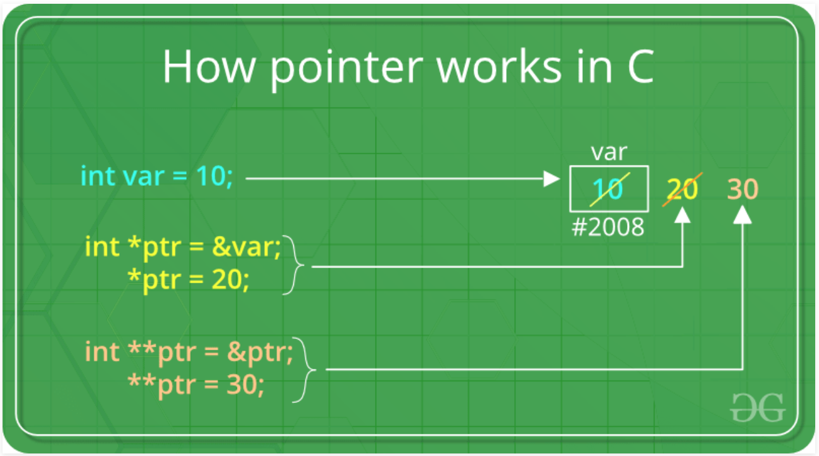
Double Pointer- (ref: https://www.geeksforgeeks.org/double-pointer-pointer-pointer-c/)
Example:
int **ptr

Slide 26
